Slide 1
FindIt
Lost & Found Management System
A community-powered platform for university campuses to report, search, and
reconnect lost belongings with their owners.
PHP
MySQL
Bootstrap 5
AJAX
Syed Muhammad Yousuf Ali Zaidi (BCB-25F-043)
Aiman Imam (BCB-25F-006)
Najia Batool (BCB-25F-033)
Sindh Madressatul Islam University (SMIU) · BS Cyber Security · 2nd Semester

Slide 2


Project Objective
Every semester, students lose phones, wallets, ID cards, and bags across campus with no central, reliable way to report or recover them. FindIt solves this by giving the whole campus community one place to report lost items, post found items, search and filter listings, and connect directly with the other party to arrange a return under the admin supervision.
Core Goal
Reduce time-to-recovery for lost items
Give security staff a moderation workflow
Keep every report searchable & filterable
Enable safe, direct student-to-student contact
3
2
100%
User Roles
Report Types
AJAX-driven UI
FindIt — Lost & Found Management System
2

Slide 3






Key Features
Report Lost / Found
Search & Filter
Direct Messaging
Dual-mode reporting with category, location, date & photo.
Live keyword search plus type & category filters.
In-app messages link finder and owner per item.
Role-Based Access
Image Uploads
Admin Dashboard
Students and admin permission levels.
Attach photos to listings for faster identification.
Approve, resolve, or remove reports campus-wide.
FindIt — Lost & Found Management System
3

Slide 4
System Modules
The three functional modules defined in the project
01
02
03
User Authentication Module
Item Management Module
Search & Filter Module
Ensures only verified university students and faculty can access the system by verify id — register, log in, and get a role-based session.
Let users submit detailed lost/found forms — item name, description, date, time, and specific location.
Let users categorize searches (Electronics, Documents, Accessories, etc.) to quickly find relevant listings.
FindIt — Lost & Found Management System
4

Slide 5



System Architecture
Three-tier structure: browser front end, PHP API layer, MySQL storage
Client
API Layer
Database
index.html
PHP endpoints
MySQL
• Vanilla JS + AJAX
• auth.php
• users
• Bootstrap-style UI
• items.php
• items
• Session-aware views
• messages.php
• messages
• admin.php
FindIt — Lost & Found Management System
5

Slide 6
Database Schema
Three related tables enforce referential integrity via foreign keys
users
items
messages
id PK
id PK
id PK
name
user_id FK → users
item_id FK → items
email UNIQUE
type lost / found
sender_id FK → users
password
title, category
receiver_id FK → users
role user / admin
description, location
message
created_at
status open/resolved/pending
is_read, created_at
1 user → many items 1 item → many messages 1 user → many messages sent/received
FindIt — Lost & Found Management System
6

Slide 7


Implementation Highlights
Core item-reporting logic, secured with prepared statements
function add_lost_item($name, $category,
$location, $date) {
$conn = new mysqli($host, $user,
$pass, $db);
$stmt = $conn->prepare(
"INSERT INTO items (title, category,
location, date) VALUES
(?, ?, ?, ?)"
);
$stmt->bind_param("ssss", $name,
$category, $location,
$date);
$stmt->execute();
}
Prepared statements throughout
Every insert/update/select uses bind_param — the report names this the top priority for securely connecting PHP to MySQL.
Standardized location input
Free-text location fields were replaced with predefined dropdown menus to keep data consistent for search & filtering.
Form validation in JS
Client-side checks catch missing fields before submission; the server re-validates on arrival.
FindIt — Lost & Found Management System
7

Slide 8
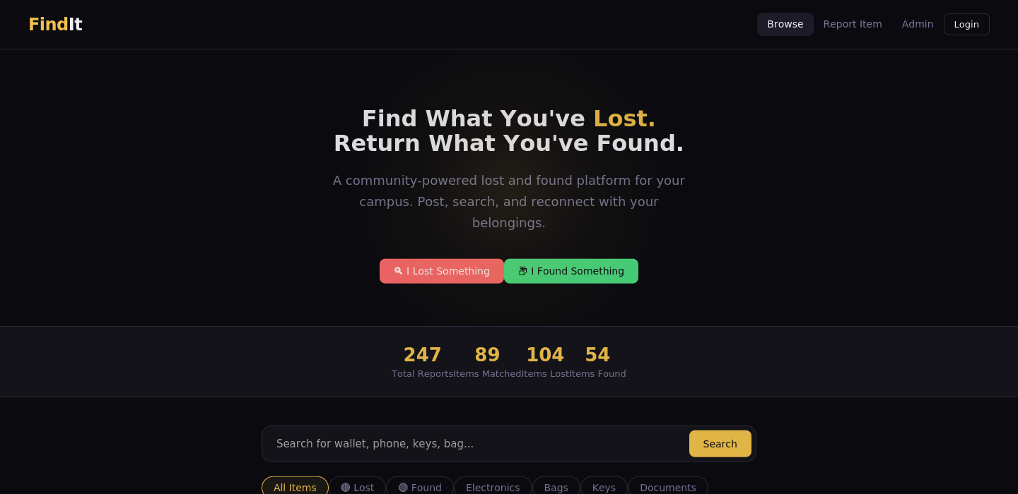
Browse & Discover
Public homepage — no login required to search listings
Live campus stats
Total reports, matches, and resolved counts update from the database.
One-tap reporting
"I Lost Something" / "I Found Something" CTAs jump straight to the form.
Instant search
Keyword search across title, description, and location.
FindIt — Lost & Found Management System
8

Slide 9
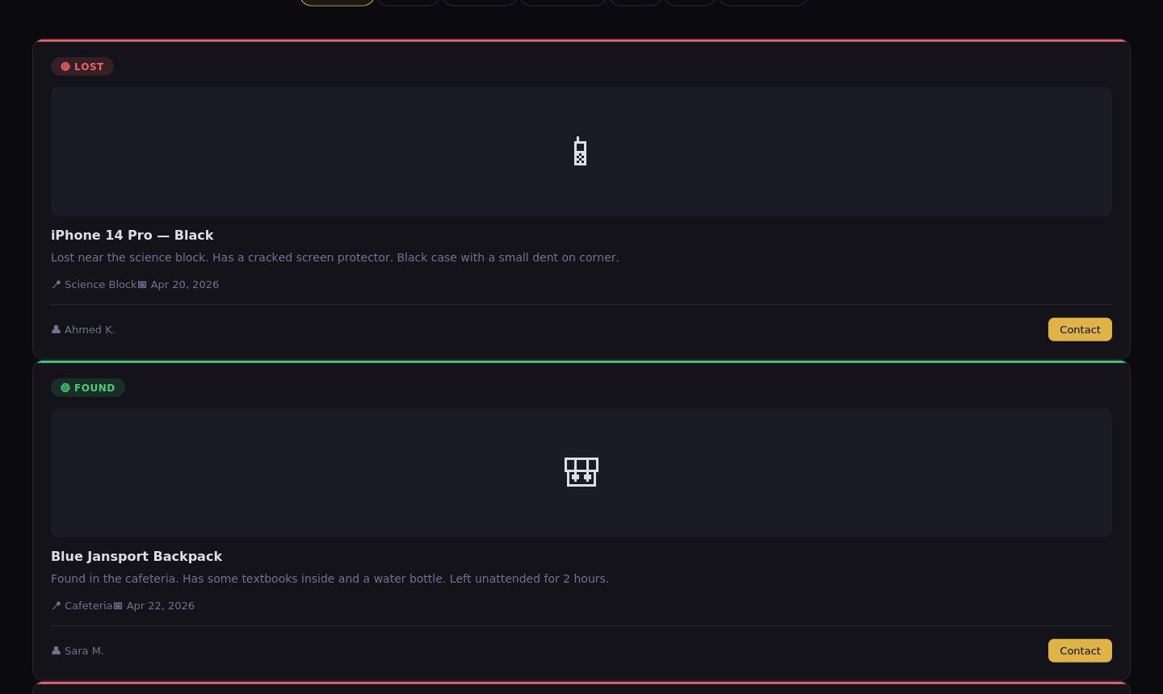
Item Listings
Filterable card grid with category chips and status badges
Status badges
Color-coded LOST (red) / FOUND (green) tags for instant scanning.
Category filters
Electronics, bags, keys, documents, clothing, jewelry, other.
Reporter contact
Direct "Contact" action opens the messaging flow.
FindIt — Lost & Found Management System
9

Slide 10
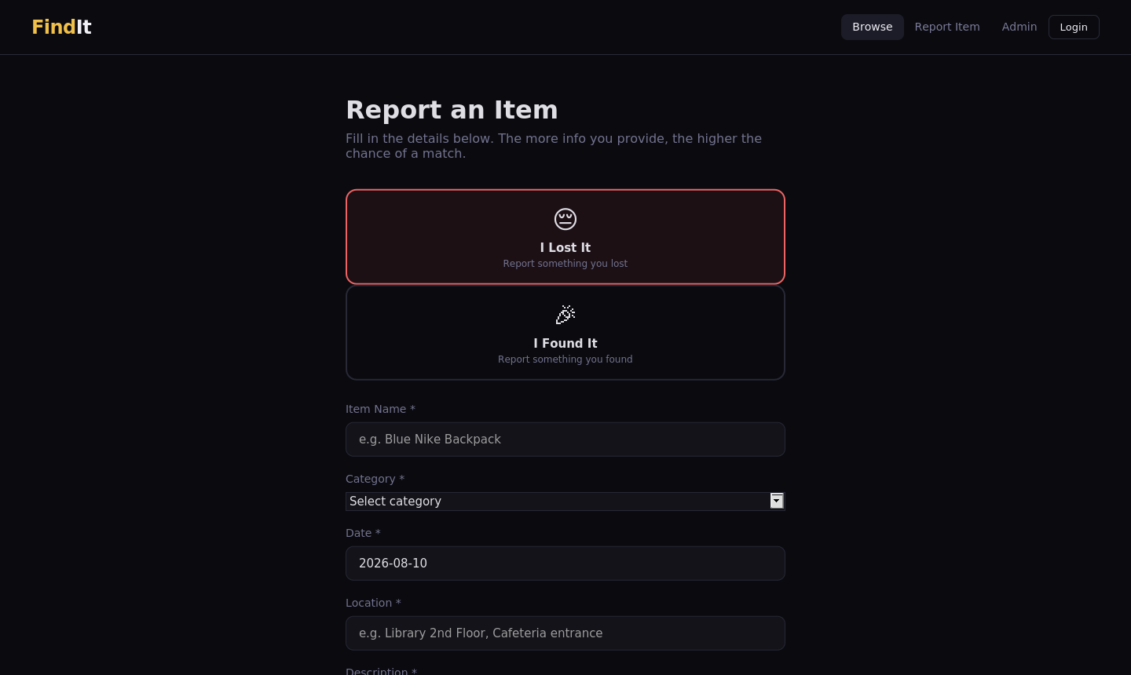
Report an Item
AJAX form posts to items.php with optional image upload
Lost / Found toggle
Single form adapts copy & fields for either report type.
Structured metadata
Category, date, and location captured for accurate matching.
Validated uploads
Images restricted to jpg/png/gif/webp, capped at 5MB server-side.
FindIt — Lost & Found Management System
10

Slide 11
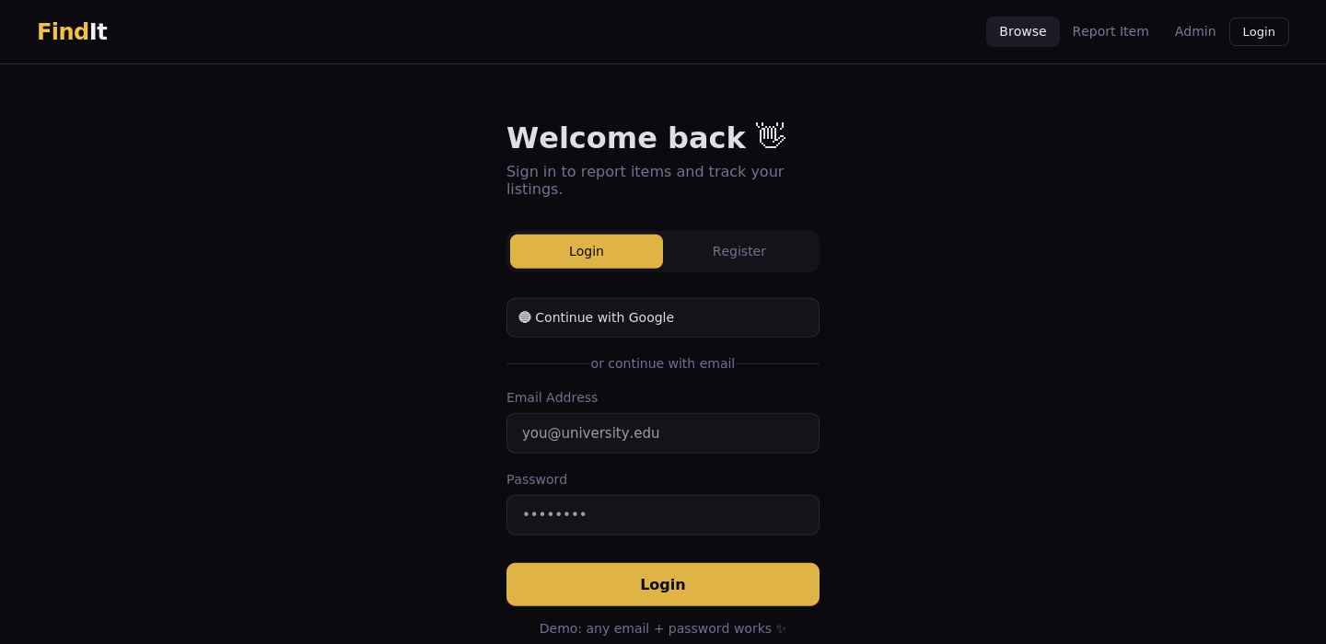
Authentication
Session-based login & registration with bcrypt-hashed passwords
Register & login
Single tabbed panel, backed by auth.php.
Secure by default
password_hash() / password_verify() — no plaintext storage.
Role assigned at signup
New accounts default to "user"; admins are provisioned separately.
FindIt — Lost & Found Management System
11

Slide 12
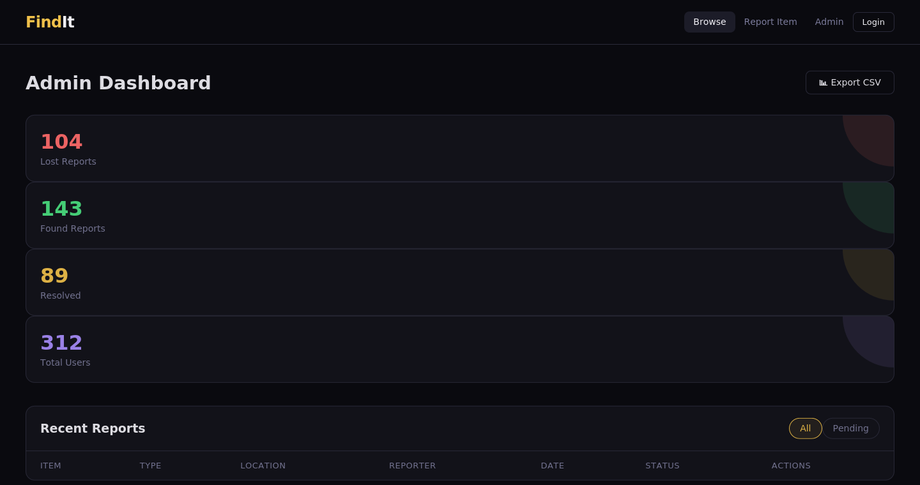
Admin Dashboard
Restricted to accounts with role = admin (server-side check)
Platform-wide stats
Lost, found, resolved counts and total registered users.
Report moderation
Approve, resolve, or delete any item from one table.
CSV export
Pull the full report list for offline record-keeping.
FindIt — Lost & Found Management System
12

Slide 13

Challenges & Solutions
Two issues called out in the project report, and how they were resolved
Securing the PHP–MySQL connection
Inconsistent location data
Challenge
Challenge
Preventing SQL injection while connecting the backend to the database was the top priority during development.
Free-text location fields led to inconsistent, hard-to-search entries (e.g. "Library", "lib", "Central Library").
Solution
Solution
Resolved by using PHP prepared statements (mysqli bind_param) for every database query, with no raw string concatenation.
Standardized by replacing text inputs with predefined HTML dropdown menus for campus locations.
FindIt — Lost & Found Management System
13

Slide 14

Security & Data Handling
Password Hashing
Prepared Statements
bcrypt via password_hash() — passwords are never stored or compared in plaintext.
Every query uses mysqli bind_param, closing off SQL-injection vectors.
Server-Side Role Checks
Upload Validation
Admin routes verify $_SESSION['user_role'] on the server, not just hidden in the UI.
Image extension whitelist and a 5MB size cap enforced before any file is saved.
FindIt — Lost & Found Management System
14

Slide 15


Future Enhancements
Named directly as future work in the project report
01
02
03
Mobile Push Notifications
Smart Auto-Matching
Advanced Filtering
Alert users the moment a potential match or new message arrives, per the report's future work.
Score lost vs. found reports by category, location & date to suggest likely matches.
Deeper filter combinations (date range, multi-category) beyond the current search & filter module.
FindIt — Lost & Found Management System
15

Slide 16
FindIt
Thank You
Questions & Discussion
Syed Muhammad Yousuf Ali Zaidi (BCB-25F-043)
Aiman Imam (BCB-25F-006)
Najia Batool (BCB-25F-033)
Sindh Madressatul Islam University (SMIU) · BS Cyber Security · 2nd Semester

